Slide 1
미니프로젝트 데이터설계서
데이터설계_O반_1871434_조 민정

Slide 2
데이터 설계
엔티티 기술서
논리적 설계
물리적 설계
테이블 명세서
DDL

Slide 3
엔티티 기술서
엔티티명 | 속성명
재고 | 상품위치코드, 재고수량
옷 | 상품명, 색상, 사이즈, 판매가, 할인판매가, 할인기간, 제품설명, 판매량, 당일발송여부, 평균별점, 품절여부
모델 | 모델명, 모델 키, 모델 몸무게, 상의 사이즈, 하의 사이즈
카테고리 | best, new 10%, 당일발송, outer, top, pants, sk&dress
고객 | 회원이름, 생년월일, 이메일, 회원 ID, 비밀번호, 휴대폰 번호, 회원 등급
직원 | 직원 ID, 비밀번호, 이름, 부서명, 주민등록번호, 생년월일, 나이, 입사일자
포인트 | 일자, 구분, 사용내역, 증감포인트, 잔여 포인트

Slide 4
엔티티 기술서
엔티티명 | 속성명
쿠폰 | 쿠폰내용, 사용여부, 유효 기간
문의 | 문의 날짜, 문의 종류, 문의 내용, 비밀번호, 답변한 날짜, 답변 내용
장바구니 | 결제예상금액, 수량
주문 | 주문번호, 주문일자, 총 주문 가격, 할인된 가격, 결제 방법, 총 결제 가격, 배송지 정보, 택배사, 운송번호
구매상태 | 입금 전, 입금 확인, 출고 준비 중, 배송 중, 배송 완료, 구매 확정, 환불 신청, 환불 완료, 교환 신청, 교환 완료
환불 | 환불 예상 금액, 환불 사유, 별도의 배송비
교환 | 교환 사유, 별도의 배송비
리뷰&별점 | 리뷰내용, 별점

Slide 5
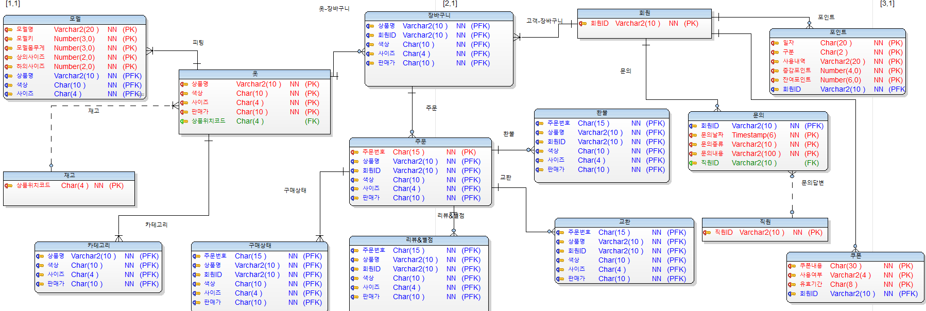
논리적 설계

Slide 6
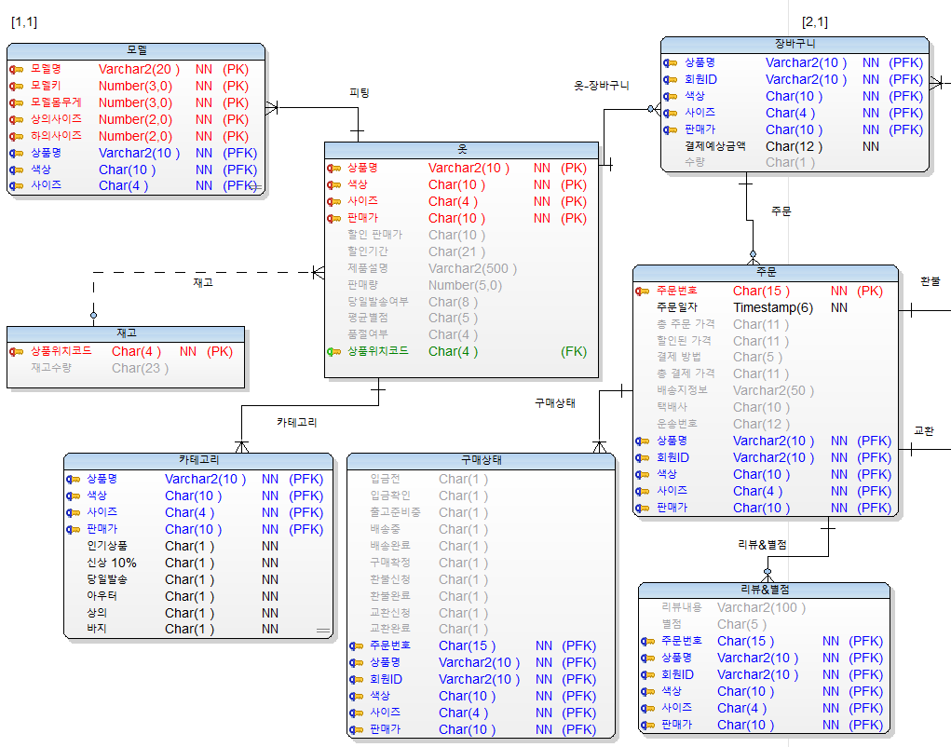
논리적 설계

Slide 7
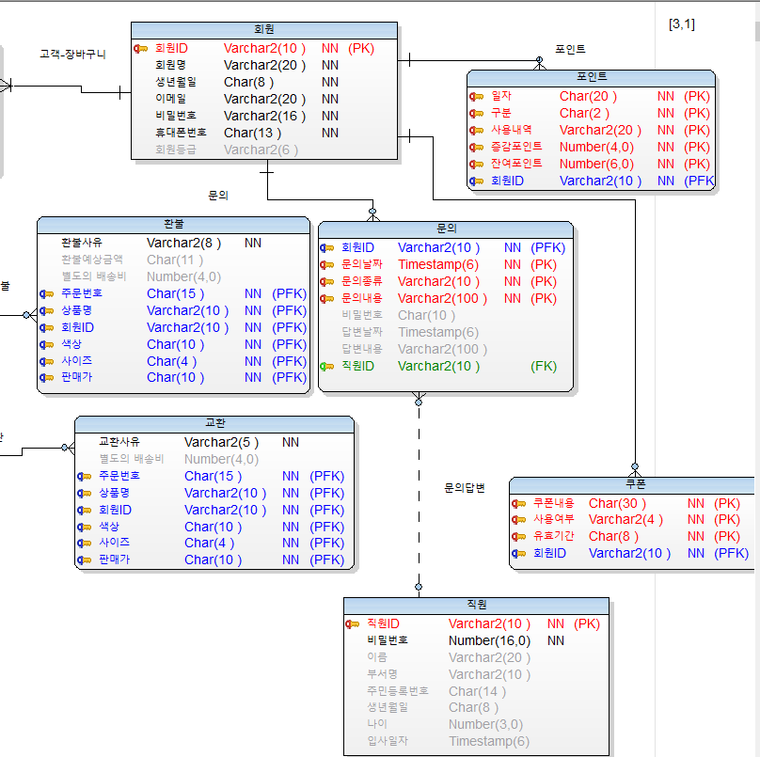
논리적 설계

Slide 8
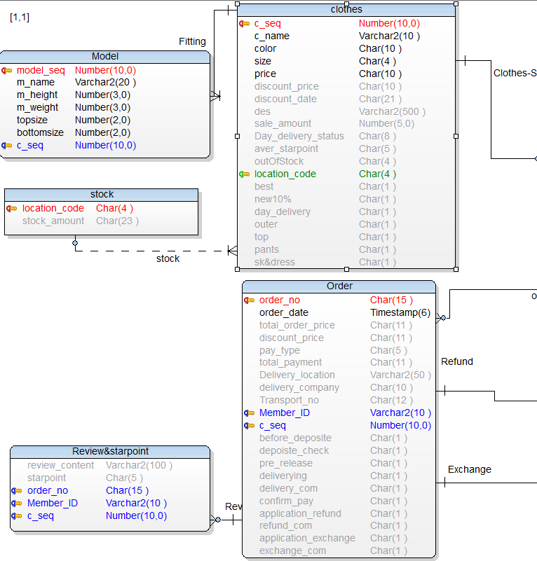
물리적 설계

Slide 9
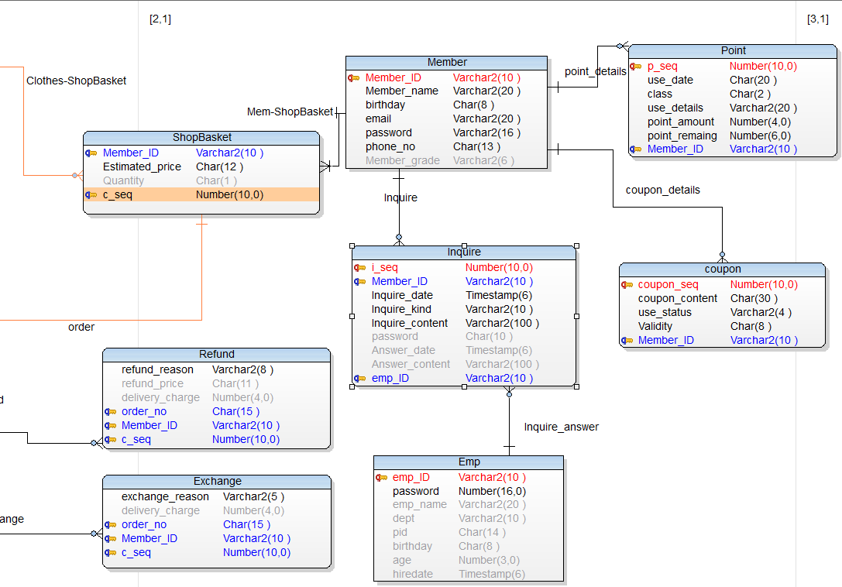
물리적 설계

Slide 10
테이블명세서
Table Name | Stock | Desciption | 재고
Refer To |  | Refered By | clothes
Attribute | DataType | Caption | PK | FK | N/N | Default
location_code | Char(4) | 상품위치코드 | ○
stock_amount | Char(23) | 재고수량

Slide 11
테이블명세서
Table Name | Clothes | Desciption | 옷
Refer To | Stock | Refered By | Review&starpoint, Order, Model, ShopBasket, Refund, Excahnge
Attribute | DataType | Caption | PK | FK | N/N | Default
c_seq | Number(10) | 옷구분 | ○
c_name | Varchar2(10) | 상품명 |  |  | ○
color | Char(10) | 색상 |  |  | ○
size | Char(4) | 사이즈 |  |  | ○
price | Char(10) | 판매가 |  |  | ○
discount_price | Char(10) | 할인판매가
discount_date | Char(21) | 할인기간
des | Varchar2(500) | 제품설명
sale_amount | Number(5) | 판매량
day_delivery_status | Char(8) | 당일발송여부

Slide 12
테이블명세서
Table Name | Clothes | Desciption | 옷
Refer To | Stock | Refered By | Review&starpoint, Order, Model, ShopBasket, Refund, Excahnge
Attribute | DataType | Caption | PK | FK | N/N | Default
aver_starpoint | Char(5) | 평균별점
outOfStock | Char(4) | 품절여부
best | Char(1) | 인기상품
new10% | Char(1) | 신상10%
day_delivery | Char(1) | 당일발송
outer | Char(1) | 아우터
top | Char(1) | 상의
pants | Char(1) | 바지
sk&dress | Char(1) | 치마&바지
location_code | Char(4) | 상품위치코드 |  | ○

Slide 13
테이블명세서
Table Name | Model | Desciption | 모델
Refer To | Clothes | Refered By
Attribute | DataType | Caption | PK | FK | N/N | Default
model_seq | Number(10) | 모델구분 | ○
m_name | Varchar2(20) | 모델명 |  |  | ○
m_height | Number(3) | 모델키 |  |  | ○
m_weight | Number(3) | 모델몸무게 |  |  | ○
topsize | Number(2) | 상의사이즈 |  |  | ○
bottomsize | Number(2) | 하의사이즈 |  |  | ○
c_seq | Number(10) | 옷구분 |  | ○

Slide 14
테이블명세서
Table Name | Member | Desciption | 회원
Refer To |  | Refered By | Review&starpoint, Order, ShopBasket, Refund, Exchange, Inquire, Point, Coupon
Attribute | DataType | Caption | PK | FK | N/N | Default
member_ID | Varchar2(10) | 회원ID | ○
member_name | Varchar2(20) | 회원명 |  |  | ○
birthday | Char(8) | 생년월일 |  |  | ○
email | Varchar2(20) | 이메일 |  |  | ○
password | Varchar2(16) | 비밀번호 |  |  | ○
phone_no | Char(13) | 휴대폰번호 |  |  | ○
member_grade | Varchar2(6) | 회원등급 |  |  |  | sysdata

Slide 15
테이블명세서
Table Name | Emp | Desciption | 직원
Refer To |  | Refered By | Inquire
Attribute | DataType | Caption | PK | FK | N/N | Default
emp_ID | Varchar2(10) | 직원ID | ○
password | Number(16) | 비밀번호 |  |  | ○
emp_name | Varchar2(20) | 이름
dept | Varchar2(10) | 부서명
pid | Char(14) | 주민등록번호
birthday | Char(8) | 생년월일
age | Number(3) | 나이
hiredate | Timestamp(6) | 입사일자

Slide 16
테이블명세서
Table Name | Point | Desciption | 포인트
Refer To | Member | Refered By
Attribute | DataType | Caption | PK | FK | N/N | Default
p_seq | Number(10) | 포인트구분 | ○
use_date | Char(20) | 일자 |  |  | ○
class | Char(2) | 구분 |  |  | ○
use_details | Varchar2(20) | 사용내역 |  |  | ○
point_amount | Number(4) | 증감포인트 |  |  | ○
point_remaining | Number(6) | 잔여포인트 |  |  | ○
member_ID | Varchar2(10) | 회원ID |  | ○

Slide 17
테이블명세서
Table Name | Coupon | Desciption | 쿠폰
Refer To | Member | Refered By
Attribute | DataType | Caption | PK | FK | N/N | Default
coupon_seq | Number(10) | 쿠폰구분 | ○
coupon_content | Char(30) | 쿠폰내용 |  |  | ○
use_status | Varchar2(4) | 사용여부 |  |  | ○
validity | Char(8) | 유효기간 |  |  | ○
memberID | Varchar2(10) | 회원ID |  |  | ○

Slide 18
테이블명세서
Table Name | Inquire | Desciption | 문의
Refer To | Member, Emp | Refered By
Attribute | DataType | Caption | PK | FK | N/N | Default
i_seq | Number(10) | 문의구분 | ○
memberID | Varchar2(10) | 회원ID |  | ○
inquire_date | Timestamp(6) | 문의날짜 |  |  | ○
inquire_kind | Varchar2(10) | 문의종류 |  |  | ○
inquire_content | Varchar2(100) | 문의내용 |  |  | ○
password | Char(10) | 비밀번호
answer_date | Timestamp(6) | 답변날짜
answer_content | Varchar2(100) | 답변내용
emp_ID | Varchar2(10) | 직원ID |  | ○

Slide 19
테이블명세서
Table Name | ShopBasket | Desciption | 장바구니
Refer To | Member, Clothes | Refered By
Attribute | DataType | Caption | PK | FK | N/N | Default
memberID | Varchar2(10) | 회원ID |  | ○
estimated_price | Char(12) | 결제예상금액 |  |  | ○
quantity | Char(1) | 수량
c_seq | Number(10) | 옷구분 |  | ○

Slide 20
테이블명세서
Table Name | Order | Desciption | 주문
Refer To | Member, Clothes | Refered By | Review&starpoint, Refund, Exchange
Attribute | DataType | Caption | PK | FK | N/N | Default
order_no | Char(15) | 주문번호 | ○
order_date | Timstamp(6) | 주문일자 |  |  | ○
total_order_price | Char(11) | 총 주문 가격
discount_price | Char(11) | 할인된 가격
pay_type | Char(5) | 결제 방법
total_payment | Char(11) | 총 결제 가격
delivery_location | Varchar2(50) | 배송지 정보
delivery_company | Char(10) | 택배사
transport_no | Char(12) | 운송번호
memberID | Varchar2(10) | 회원ID |  | ○

Slide 21
테이블명세서
Table Name | Order | Desciption | 주문
Refer To | Member, Clothes | Refered By | Review&starpoint, Refund, Exchange
Attribute | DataType | Caption | PK | FK | N/N | Default
c_seq | Number(10) | 옷구분 |  | ○
before_deposite | Char(1) | 입금전
deposite_check | Char(1) | 입금확인
pre_release | Char(1) | 출고준비중
deliverying | Char(1) | 배송중
delivery_com | Char(1) | 배송완료
confirm_pay | Char(1) | 구매확정
application_refund | Char(1) | 환불신청
refund_com | Char(1) | 환불완료
application_exchange | Char(1) | 교환신청
exchange_com | Char(1) | 교환완료

Slide 22
테이블명세서
Table Name | Refund | Desciption | 환불
Refer To | Order, Member, Clothes | Refered By
Attribute | DataType | Caption | PK | FK | N/N | Default
refund_reason | Varchar2(8) | 환불사유 |  |  | ○
refund_price | Char(11) | 환불예상금액
delivery_charge | Number(4) | 별도의 배송비
order_no | Char(15) | 주문번호 |  | ○
memberID | Varchar2(10) | 회원ID |  | ○
c_seq | Number(10) | 옷구분 |  | ○

Slide 23
테이블명세서
Table Name | Exchange | Desciption | 교환
Refer To | Order, Member, Clothes | Refered By
Attribute | DataType | Caption | PK | FK | N/N | Default
exchange_reason | Varchar2(5) | 교환사유 |  |  | ○
delivery_charge | Number(4) | 별도의 배송비
order_no | Char(15) | 주문번호 |  | ○
memberID | Varchar2(10) | 회원ID |  | ○
c_seq | Number(10) | 옷구분 |  | ○

Slide 24
테이블명세서
Table Name | Reivew&starpoint | Desciption | 리뷰&별점
Refer To | Order, Member, Clothes | Refered By
Attribute | DataType | Caption | PK | FK | N/N | Default
review_content | Varchar2(100) | 리뷰내용
starpoint | Char(5) | 별점
order_no | Char(15) | 주문번호 |  | ○
memberID | Varchar(10) | 회원ID |  | ○
c_seq | Number(10) | 옷구분 |  | ○

Slide 25
DDL
TableName | Stock
CREATE TABLE "Stock"(
"location_code" Char(4 ) NOT NULL,
"stock_amount" Char(23 )
)
ALTER TABLE "Stock" ADD CONSTRAINT "PK_stock" PRIMARY KEY ("location_code")

Slide 26
DDL
TableName | Clothes
CREATE TABLE "clothes"(
"c_seq" Number(10,0) NOT NULL,
"c_name" Varchar2(10 ) NOT NULL,
"color" Char(10 ) NOT NULL,
"size" Char(4 ) NOT NULL,
"price" Char(10 ) NOT NULL,
"discount_price" Char(10 ),
"discount_date" Char(21 ),
"des" Varchar2(500 ),
"sale_amount" Number(5,0),
"Day_delivery_status" Char(8 ),
"aver_starpoint" Char(5 ),
"outOfStock" Char(4 ),
"location_code" Char(4 ),
"best" Char(1 ),
"new10%" Char(1 ),
"day_delivery" Char(1 ),
"outer" Char(1 ),
"top" Char(1 ),
"pants" Char(1 ),
"sk&dress" Char(1 )
)
ALTER TABLE "clothes" ADD CONSTRAINT "PK_clothes" PRIMARY KEY ("c_seq")
ALTER TABLE "clothes" ADD CONSTRAINT "stock" FOREIGN KEY ("location_code") REFERENCES "stock" ("location_code")

Slide 27
DDL
TableName | Model
CREATE TABLE "Model"(
"model_seq" Number(10,0) NOT NULL,
"m_name" Varchar2(20 ) NOT NULL,
"m_height" Number(3,0) NOT NULL,
"m_weight" Number(3,0) NOT NULL,
"topsize" Number(2,0) NOT NULL,
"bottomsize" Number(2,0) NOT NULL,
"c_seq" Number(10,0) NOT NULL
)
ALTER TABLE "Model" ADD CONSTRAINT "PK_Model" PRIMARY KEY ("model_seq","c_seq")
ALTER TABLE "Model" ADD CONSTRAINT "Fitting" FOREIGN KEY ("c_seq") REFERENCES "clothes" ("c_seq")

Slide 28
DDL
TableName | Member
CREATE TABLE "Member"(
"Member_ID" Varchar2(10 ) NOT NULL,
"Member_name" Varchar2(20 ) NOT NULL,
"birthday" Char(8 ) NOT NULL,
"email" Varchar2(20 ) NOT NULL,
"password" Varchar2(16 ) NOT NULL,
"phone_no" Char(13 ) NOT NULL,
"Member_grade" Varchar2(6 ) DEFAULT Member
)
ALTER TABLE "Member" ADD CONSTRAINT "PK_Member" PRIMARY KEY ("Member_ID")

Slide 29
DDL
TableName | Emp
CREATE TABLE "Emp"(
"emp_ID" Varchar2(10 ) NOT NULL,
"password" Number(16,0) NOT NULL,
"emp_name" Varchar2(20 ),
"dept" Varchar2(10 ),
"pid" Char(14 ),
"birthday" Char(8 ),
"age" Number(3,0),
"hiredate" Timestamp(6)
)
ALTER TABLE "Emp" ADD CONSTRAINT "PK_Emp" PRIMARY KEY ("emp_ID")

Slide 30
DDL
TableName | Point
CREATE TABLE "Point"(
"p_seq" Number(10,0) NOT NULL,
"use_date" Char(20 ) NOT NULL,
"class" Char(2 ) NOT NULL,
"use_details" Varchar2(20 ) NOT NULL,
"point_amount" Number(4,0) NOT NULL,
"point_remaing" Number(6,0) NOT NULL,
"Member_ID" Varchar2(10 ) NOT NULL
)
ALTER TABLE "Point" ADD CONSTRAINT "PK_Point" PRIMARY KEY ("Member_ID","p_seq")
ALTER TABLE "Point" ADD CONSTRAINT "point_details" FOREIGN KEY ("Member_ID") REFERENCES "Member" ("Member_ID")

Slide 31
DDL
TableName | Coupon
CREATE TABLE "coupon"(
"coupon_seq" Number(10,0) NOT NULL,
"coupon_content" Char(30 ) NOT NULL,
"use_status" Varchar2(4 ) NOT NULL,
"Validity" Char(8 ) NOT NULL,
"Member_ID" Varchar2(10 ) NOT NULL
)
ALTER TABLE "coupon" ADD CONSTRAINT "PK_coupon" PRIMARY KEY ("Member_ID","coupon_seq")
ALTER TABLE "coupon" ADD CONSTRAINT "coupon_details" FOREIGN KEY ("Member_ID") REFERENCES "Member" ("Member_ID")

Slide 32
DDL
TableName | Inquire
CREATE TABLE "Inquire"(
"i_seq" Number(10,0) NOT NULL,
"Member_ID" Varchar2(10 ) NOT NULL,
"Inquire_date" Timestamp(6) NOT NULL,
"Inquire_kind" Varchar2(10 ) NOT NULL,
"Inquire_content" Varchar2(100 ) NOT NULL,
"password" Char(10 ),
"Answer_date" Timestamp(6),
"Answer_content" Varchar2(100 ),
"emp_ID" Varchar2(10 ) NOT NULL
)
ALTER TABLE "Inquire" ADD CONSTRAINT "PK_Inquire" PRIMARY KEY ("Member_ID","i_seq","emp_ID")
ALTER TABLE "Inquire" ADD CONSTRAINT "Inquire" FOREIGN KEY ("Member_ID") REFERENCES "Member" ("Member_ID")
ALTER TABLE "Inquire" ADD CONSTRAINT "Inquire_answer" FOREIGN KEY ("emp_ID") REFERENCES "Emp" ("emp_ID")

Slide 33
DDL
TableName | ShopBasket
CREATE TABLE "ShopBasket"(
"Member_ID" Varchar2(10 ) NOT NULL,
"Estimated_price" Char(12 ) NOT NULL,
"Quantity" Char(1 ),
"c_seq" Number(10,0) NOT NULL
)
ALTER TABLE "ShopBasket" ADD CONSTRAINT "PK_ShopBasket" PRIMARY KEY ("Member_ID","c_seq")
ALTER TABLE "ShopBasket" ADD CONSTRAINT "Clothes-ShopBasket" FOREIGN KEY ("c_seq") REFERENCES "clothes" ("c_seq")
ALTER TABLE "ShopBasket" ADD CONSTRAINT "Mem-ShopBasket" FOREIGN KEY ("Member_ID") REFERENCES "Member" ("Member_ID")

Slide 34
DDL
TableName | Order
CREATE TABLE "Order"(
"order_no" Char(15 ) NOT NULL,
"order_date" Timestamp(6) NOT NULL,
"total_order_price" Char(11 ),
"discount_price" Char(11 ),
"pay_type" Char(5 ),
"total_payment" Char(11 ),
"Delivery_location" Varchar2(50 ),
"delivery_company" Char(10 ),
"Transport_no" Char(12 ),
"Member_ID" Varchar2(10 ) NOT NULL,
"c_seq" Number(10,0) NOT NULL,
"before_deposite" Char(1 ),
"depoiste_check" Char(1 ),
"pre_release" Char(1 ),
"deliverying" Char(1 ),
"delivery_com" Char(1 ),
"confirm_pay" Char(1 ),
"application_refund" Char(1 ),
"refund_com" Char(1 ),
"application_exchange" Char(1 ),
"exchange_com" Char(1 )
)
ALTER TABLE "Order" ADD CONSTRAINT "PK_Order" PRIMARY KEY ("order_no","Member_ID","c_seq")
ALTER TABLE "Order" ADD CONSTRAINT "order" FOREIGN KEY ("Member_ID", "c_seq") REFERENCES "ShopBasket" ("Member_ID", "c_seq")

Slide 35
DDL
TableName | Refund
CREATE TABLE "Refund"(
"refund_reason" Varchar2(8 ) NOT NULL,
"refund_price" Char(11 ),
"delivery_charge" Number(4,0),
"order_no" Char(15 ) NOT NULL,
"Member_ID" Varchar2(10 ) NOT NULL,
"c_seq" Number(10,0) NOT NULL
)
ALTER TABLE "Refund" ADD CONSTRAINT "PK_Refund" PRIMARY KEY ("order_no","Member_ID","c_seq")
ALTER TABLE "Refund" ADD CONSTRAINT "Refund" FOREIGN KEY ("order_no", "Member_ID", "c_seq") REFERENCES "Order" ("order_no", "Member_ID", "c_seq")

Slide 36
DDL
TableName | Exchange
CREATE TABLE "Exchange"(
"exchange_reason" Varchar2(5 ) NOT NULL,
"delivery_charge" Number(4,0),
"order_no" Char(15 ) NOT NULL,
"Member_ID" Varchar2(10 ) NOT NULL,
"c_seq" Number(10,0) NOT NULL
)
ALTER TABLE "Exchange" ADD CONSTRAINT "PK_Exchange" PRIMARY KEY ("order_no","Member_ID","c_seq")
ALTER TABLE "Exchange" ADD CONSTRAINT "Exchange" FOREIGN KEY ("order_no", "Member_ID", "c_seq") REFERENCES "Order" ("order_no", "Member_ID", "c_seq")

Slide 37
DDL
TableName | Review&starpoint
CREATE TABLE "Review&starpoint"(
"review_content" Varchar2(100 ),
"starpoint" Char(5 ),
"order_no" Char(15 ) NOT NULL,
"Member_ID" Varchar2(10 ) NOT NULL,
"c_seq" Number(10,0) NOT NULL
)
ALTER TABLE "Review&starpoint" ADD CONSTRAINT "PK_Review&starpoint" PRIMARY KEY ("order_no","Member_ID","c_seq")
ALTER TABLE "Review&starpoint" ADD CONSTRAINT "Review&starpoint" FOREIGN KEY ("order_no", "Member_ID", "c_seq") REFERENCES "Order" ("order_no", "Member_ID", "c_seq")

